Slide 1





PROMIS project:
“Electron transport in novel Mid-IR materials and devices”
Resonant Zener tunnelling via
zero-dimensional states in a narrow gap InAsN diode
Davide Maria Di Paola
School of Physics and Astronomy
The University of Nottingham

Slide 2
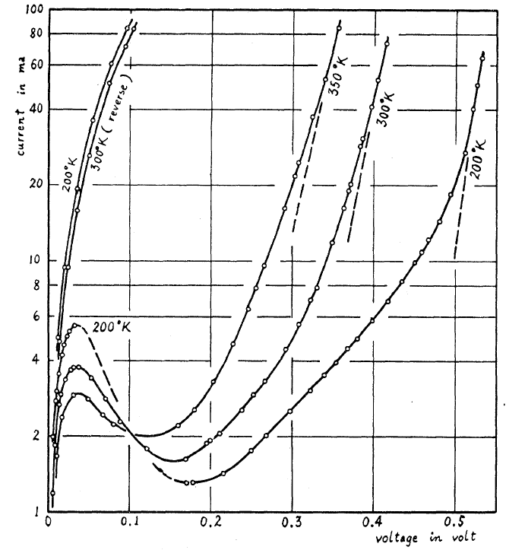
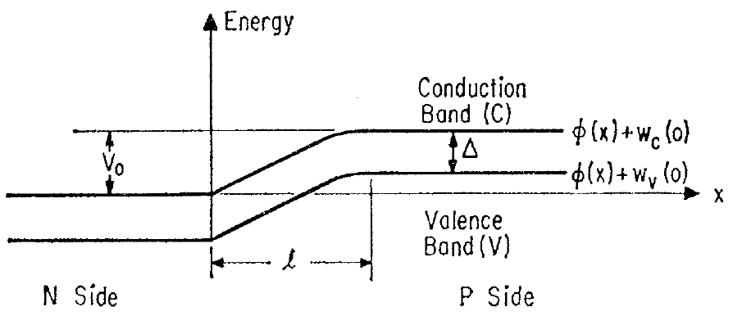
From “conventional” to 0D - Zener tunnelling
Zener tunnelling (1934)
Band-to-band tunnelling of carriers through a forbidden energy bandgap
Esaki diode (1958)
First demonstration of quantum tunnelling in a condensed matter system
A new phenomenon:
Resonant Zener tunnelling via 0D-states in the MIR InAsN
Zener, C. A.
Theory of the Electrical Breakdown of Solid Dielectrics
Proc. R. Soc. London 145, 523-529 (1934)
Esaki, L.
New Phenomenon in Narrow Germanium p-n Junctions.
Phys. Rev. 109, 603-604 (1958).
D. M. Di Paola et al.
Resonant Zener tunnelling via
zero-dimensional states in a narrow gap InAsN diode
Submitted (2016)

Slide 3
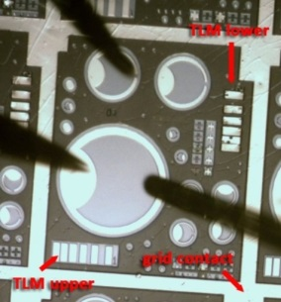
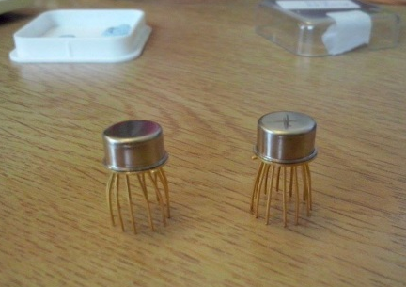
In(AsN) Resonant Tunnelling Diodes (RTDs)
A multi-layered p-i-n RTD structure grown by MBE with an InAsN QW layer embedded between two InAlAs barries.
Optical mesa diodes and TO5 headers for electrical and optical studies

Slide 4
Low-T current-voltage characteristics
Extended negative differential resistance (NDR);
Ohmic region at low bias voltages;
Additional resonance features in the differential conductance.

Slide 5
Following the NDR from low to room temperature
The NDR is not observed in InAs and is weakly affected by T
Two transport processes
Thermal diffusion
Zener tunnelling
through N-related states
(50 meV below CB)

Slide 6
Magneto-tunnelling Spectroscopy (MTS)
An e⁻ travelling a distance s under the effect of an electric field F and a transverse magnetic field B gains
Δk_{y}
B_{x}
Energy
e
Wave vector
The tunnelling current can be expressed as an overlap integral of emitter and 0D
states in k-space:
Mapping |ψ|²
in k-space
Δk ~ B
ψ_{0D}
k
Sakai, J.-W. et al Probing the wave function of quantum confined states by resonant magnetotunneling, Phys. Rev. B 48, 5664 (1993)
Vdovin E.E. et al. Imaging the Electron Wave Function in Self-Assembled Quantum Dots. Science 290, 122-124 (2000)

Slide 7
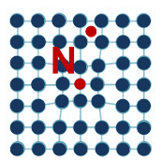
Probing the size of 0D states by MTS
Strong decrease of current I with B_{x}
From modelling of the I(B_{x}) curves, we find that the 0D states are strongly localized (λ₀ < 2 nm).
From hydrogenic model, we extract a binding energy E > 30 meV.
Coulomb potential
Parabolic potential
Which is the source of the 0D states?
Interstitial N and/or vacancies induce point defects, which may be the source for the electron localization.
Patanè, A. et al. Manipulating and Imaging the Shape of an Electronic Wave Function by Magnetotunneling Spectroscopy
Phys. Rev. Lett. 105, 236804 (2010).

Slide 8
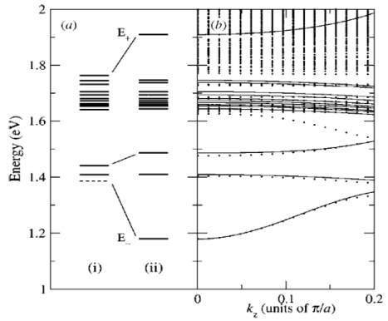
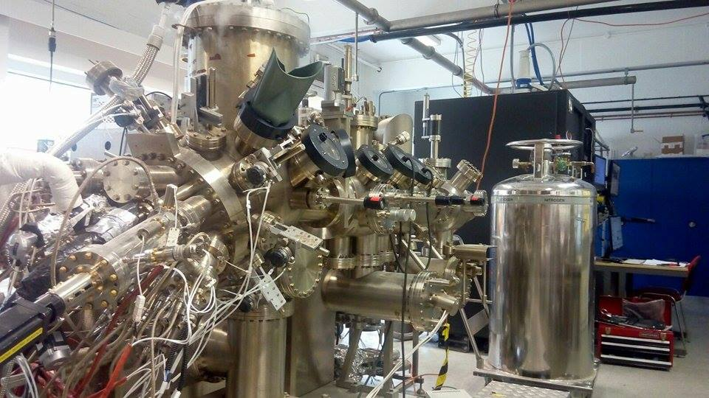
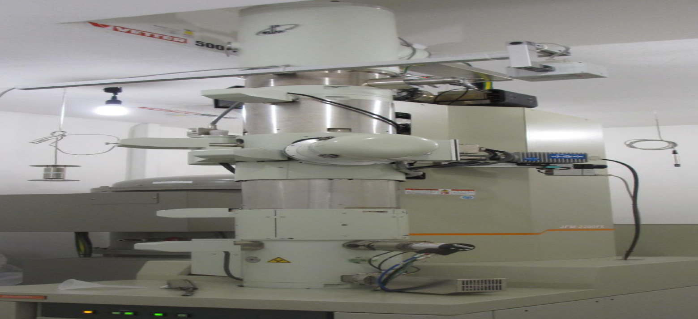
Conclusions and future studies
Evidence of localized states in InAsN leading to NDR
Some open questions to address require further study
Modelling the effects of defects on the band structure of InAsN
Influence of growth conditions (low T) on the material quality
O’Reilly, E.P., Lindsay, A., Klar, P.J., Polimeni, A., and Capizzi, M. Trends in the electronic structure of dilute nitride alloys. Semicond. Sci. Technol. 24, 033001 (2009).
MBE facilities at ULAN
Optical probing of the N-states by Electroluminescence (EL)
(in collaboration with ULAN)
Direct observation of defects (STEM)
(in collaboration with UMR)

Slide 9
Additional information

Slide 10
In(AsN) Resonant Tunnelling Diodes (RTDs)
Modelling
Bound states in the QW
Effect of doping
on the band bending
Activation energy E_{a}

Slide 11
N-related states assisted Zener Tunnelling
Resonance:
Zener tunnelling from CB to VB
Out of resonance:
NDR

Slide 12
Magneto-tunnelling Spectroscopy (MTS)
B//J
Weaker effect on peak D: magnetic confinement length (l_{z} > 6.8 nm) larger than the electron confinement length (λ₀ < 2 nm).
Sharpening of feature E₁ and small diamagnetic shift;
Quantization in the control sample.

